Slide 1
Gambling, Probability, and Risk
(Basic Probability and Counting Methods)

Slide 2
A gambling experiment
Everyone in the room takes 2 cards from the deck (keep face down)
Rules, most to least valuable:
    Pair of the same color (both red or both black)
    Mixed-color pair (1 red, 1 black)
    Any two cards of the same suit
    Any two cards of the same color
    In the event of a tie, highest card wins (ace is top)

Slide 3
What do you want to bet?
Look at your two cards.
Will you fold or bet?
What is the most rational strategy given your hand?

Slide 4
Rational strategy
There are N people in the room
What are the chances that someone in the room has a better hand than you?
Need to know the probabilities of different scenarios
We’ll return to this later in the lecture…

Slide 5
Probability
Probability – the chance that an uncertain event will occur (always between 0 and 1)
Symbols:
P(event A) = “the probability that event A will occur”
P(red card) = “the probability of a red card”
P(~event A) = “the probability of NOT getting event A” [complement]
P(~red card) = “the probability of NOT getting a red card”
P(A & B) = “the probability that both A and B happen” [joint probability]
P(red card & ace) = “the probability of getting a red ace”

Slide 6
Assessing Probability
1. Theoretical/Classical probability—based on theory (a priori understanding of a phenomena)
    e.g.: theoretical probability of rolling a 2 on a standard die is 1/6
    theoretical probability of choosing an ace from a standard deck is 4/52
    theoretical probability of getting heads on a regular coin is 1/2
2. Empirical probability—based on empirical data
    e.g.: you toss an irregular die (probabilities unknown) 100 times and find that you get a 2 twenty-five times; empirical probability of rolling a 2 is 1/4
    empirical probability of an Earthquake in Bay Area by 2032 is .62 (based on historical data)
    empirical probability of a lifetime smoker developing lung cancer is 15 percent (based on empirical data)

Slide 7
Recent headlines on earthquake probabiilites…
    http://www.guardian.co.uk/world/2011/may/26/italy-quake-experts-manslaughter-charge

Slide 8
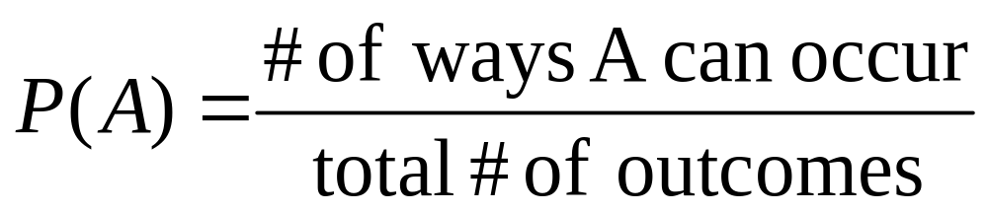
Computing theoretical probabilities:counting methods
Great for gambling! Fun to compute!
If outcomes are equally likely to occur…
Note: these are called “counting methods” because we have to count the number of ways A can occur and the number of total possible outcomes.

Slide 9
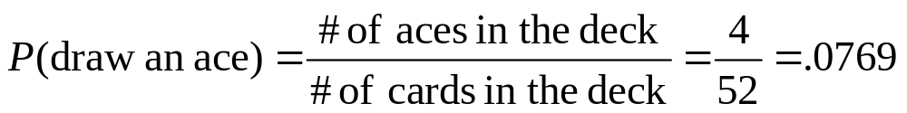
Counting methods: Example 1
Example 1: You draw one card from a deck of cards. What’s the probability that you draw an ace?

Slide 10
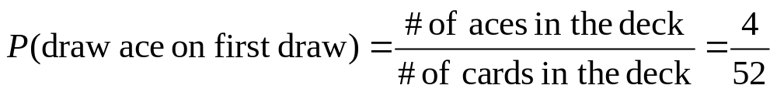
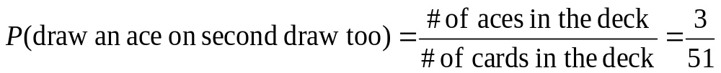
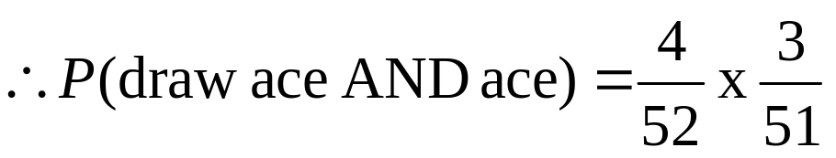
Counting methods: Example 2
Example 2. What’s the probability that you draw 2 aces when you draw two cards from the deck?
This is a “joint probability”—we’ll get back to this on Wednesday

Slide 11
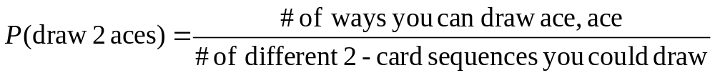
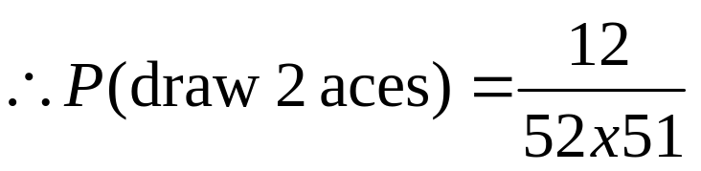
Counting methods: Example 2
Two counting method ways to calculate this:
1. Consider order:
Numerator: A♣A♦, A♣A♥, A♣A♠, A♦A♥, A♦A♠, A♦A♣, A♥A♦, A♥A♣, A♥A♠, A♠A♣, A♠A♦, or A♠A♥ = 12
52 cards
51 cards
Denominator = 52x51 = 2652 -- why?
.
.
.
.
.
.

Slide 12
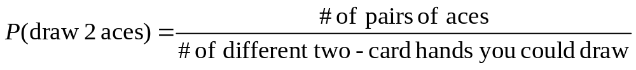
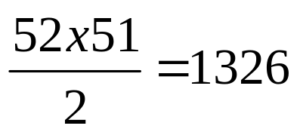
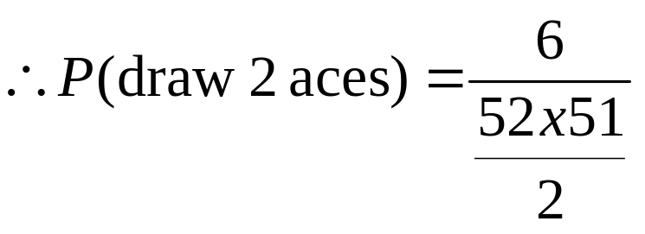
Counting methods: Example 2
2. Ignore order:
Numerator: A♣A♦, A♣A♥, A♣A♠, A♦A♥, A♦A♠, A♥A♠ = 6
Denominator =
Divide out order!

Slide 13
Summary of Counting Methods
Counting methods for computing probabilities
Combinations—
Order doesn’t matter
Permutations—order matters!
With replacement
Without replacement
Without replacement

Slide 14
Summary of Counting Methods
Counting methods for computing probabilities
Permutations—order matters!
With replacement
Without replacement

Slide 15
Permutations—Order matters!
A permutation is an ordered arrangement of objects.
With replacement=once an event occurs, it can occur again (after you roll a 6, you can roll a 6 again on the same die).
Without replacement=an event cannot repeat (after you draw an ace of spades out of a deck, there is 0 probability of getting it again).

Slide 16
Summary of Counting Methods
Counting methods for computing probabilities
Permutations—order matters!
With replacement

Slide 17
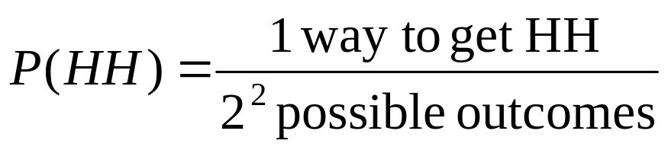
Permutations—with replacement
With Replacement – Think coin tosses, dice, and DNA.
“memoryless” – After you get heads, you have an equally likely chance of getting a heads on the next toss (unlike in cards example, where you can’t draw the same card twice from a single deck).
What’s the probability of getting two heads in a row (“HH”) when tossing a coin?
Toss 1:
2 outcomes
Toss 2:
2 outcomes
2² total possible outcomes: {HH, HT, TH, TT}
H
H
T
H
T
T

Slide 18
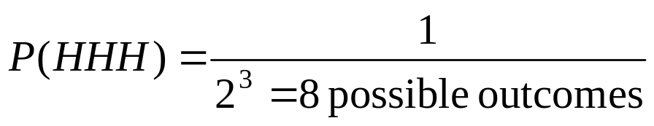
Permutations—with replacement
What’s the probability of 3 heads in a row?
Toss 3:
2 outcomes
HHH
Toss 2:
2 outcomes
H
Toss 1:
2 outcomes
HHT
T
H
HTH
H
T
H
T
HTT
T
THH
H
H
T
THT
T
H
TTH
T
TTT

Slide 19
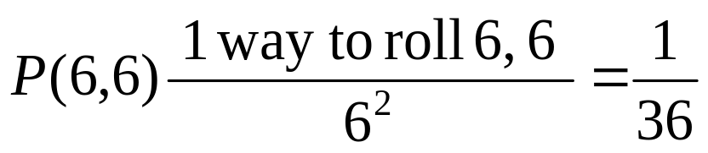
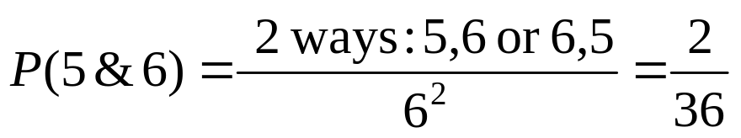
Permutations—with replacement
When you roll a pair of dice (or 1 die twice), what’s the probability of rolling 2 sixes?
What’s the probability of rolling a 5 and a 6?

Slide 20
Summary: order matters, with replacement
Formally, “order matters” and “with replacement”→ use powers→

Slide 21
Summary of Counting Methods
Counting methods for computing probabilities
Permutations—order matters!
Without replacement

Slide 22
Permutations—without replacement
Without replacement—Think cards (w/o reshuffling) and seating arrangements.
Example: You are moderating a debate of gubernatorial candidates. How many different ways can you seat the panelists in a row? Call them Arianna, Buster, Camejo, Donald, and Eve.

Slide 23
Permutation—without replacement
→ “Trial and error” method:
Systematically write out all combinations:
A B C D E
A B C E D
A B D C E
A B D E C
A B E C D
A B E D C
.
.
.
Quickly becomes a pain!
Easier to figure out patterns using a the probability tree!

Slide 24
Permutation—without replacement
Seat One:
5 possible
Seat Two:
only 4 possible
Etc….
A
A
B
B
C
…….
D
D
E
E
A
B
C
D
# of permutations = 5 x 4 x 3 x 2 x 1 = 5!
There are 5! ways to order 5 people in 5 chairs (since a person cannot repeat)

Slide 25

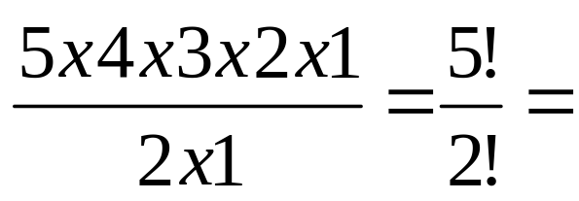
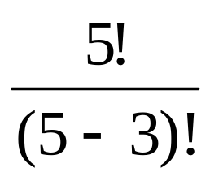
Permutation—without replacement
What if you had to arrange 5 people in only 3 chairs (meaning 2 are out)?
Seat One:
5 possible
Seat Two:
Only 4 possible
Seat Three:
only 3 possible
B
A
A
D
B
E
C
B
D
D
E
E
A
B
C
D

Slide 26
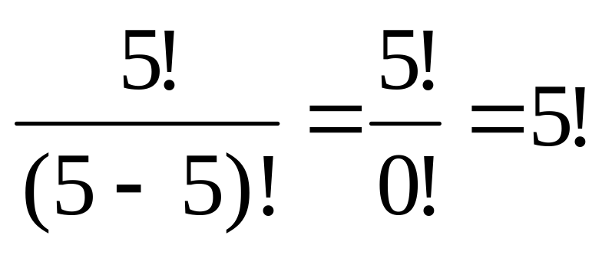
Permutation—without replacement
Note this also works for 5 people and 5 chairs:

Slide 27
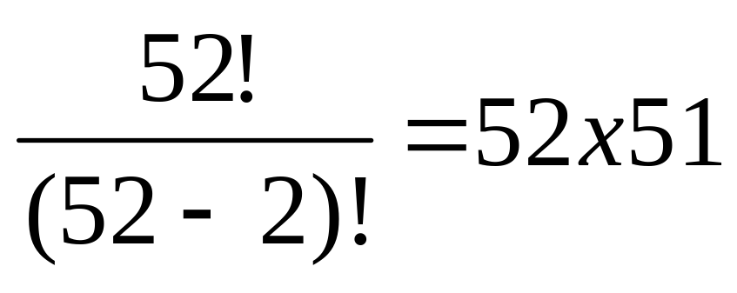
Permutation—without replacement
How many two-card hands can I draw from a deck when order matters (e.g., ace of spades followed by ten of clubs is different than ten of clubs followed by ace of spades)
52 cards
51 cards
.
.
.
.
.
.

Slide 28
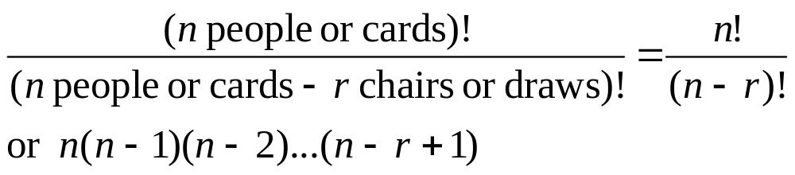
Summary: order matters, without replacement
Formally, “order matters” and “without replacement”→ use factorials→

Slide 29
Practice problems:
A wine taster claims that she can distinguish four vintages or a particular Cabernet. What is the probability that she can do this by merely guessing (she is confronted with 4 unlabeled glasses)? (hint: without replacement)
In some states, license plates have six characters: three letters followed by three numbers. How many distinct such plates are possible? (hint: with replacement)

Slide 30
Answer 1
A wine taster claims that she can distinguish four vintages or a particular Cabernet. What is the probability that she can do this by merely guessing (she is confronted with 4 unlabeled glasses)? (hint: without replacement)
P(success) = 1 (there’s only way to get it right!) / total # of guesses she could make
Total # of guesses one could make randomly:
glass one: glass two: glass three: glass four:
4 choices 3 vintages left 2 left no “degrees of freedom” left
= 4 x 3 x 2 x 1 = 4!
∴P(success) = 1 / 4! = 1/24 = .04167

Slide 31
Answer 2
In some states, license plates have six characters: three letters followed by three numbers. How many distinct such plates are possible? (hint: with replacement)
26³ different ways to choose the letters and 10³ different ways to choose the digits
∴total number = 26³ x 10³ = 17,576 x 1000 = 17,576,000

Slide 32
Summary of Counting Methods
Counting methods for computing probabilities
Combinations—
Order doesn’t matter
Without replacement

Slide 33
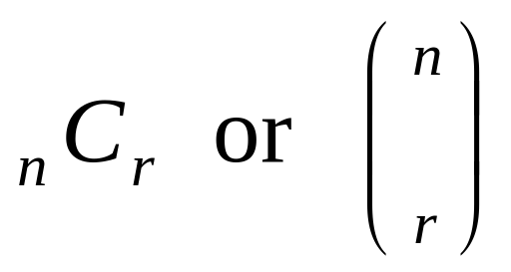
2. Combinations—Order doesn’t matter
Introduction to combination function, or “choosing”
Written as:
Spoken: “n choose r”

Slide 34
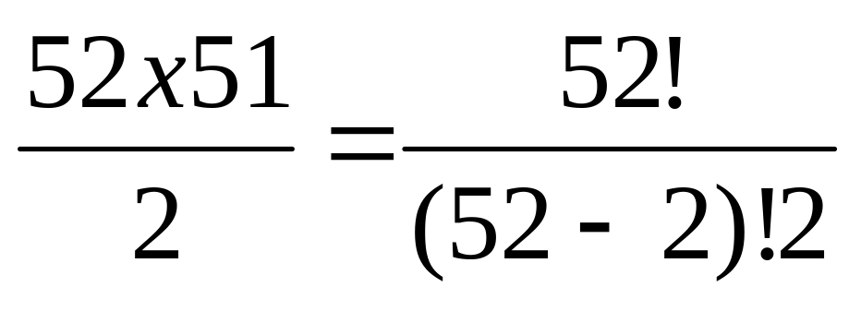
Combinations
How many two-card hands can I draw from a deck when order does not matter (e.g., ace of spades followed by ten of clubs is the same as ten of clubs followed by ace of spades)
52 cards
51 cards
.
.
.
.
.
.

Slide 35
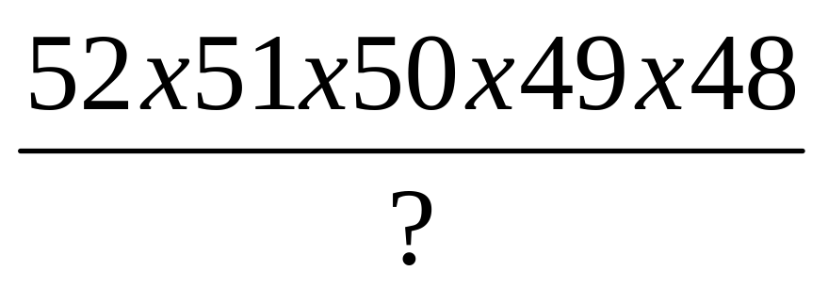
Combinations
How many five-card hands can I draw from a deck when order does not matter?
48 cards
49 cards
50 cards
51 cards
52 cards
.
.
.
.
.
.
.
.
.
.
.
.
.
.
.

Slide 36
Combinations
1.
2.
3.
….
How many repeats total??

Slide 37
Combinations
1.
2.
3.
….
i.e., how many different ways can you arrange 5 cards…?

Slide 38
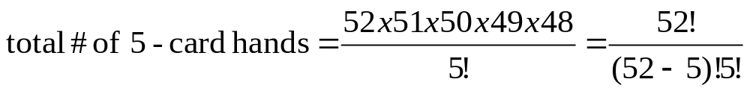
Combinations
That’s a permutation without replacement.
5! = 120

Slide 39
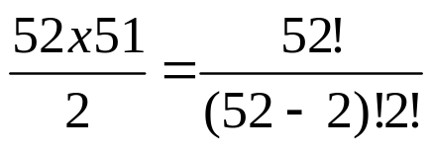
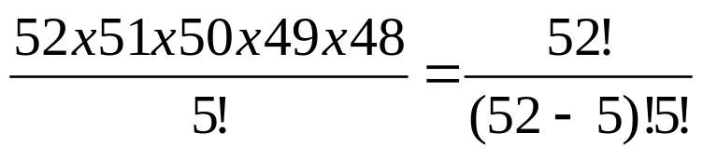
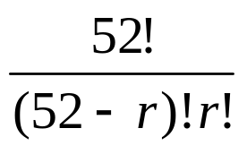
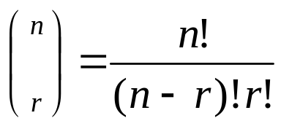
Combinations
How many unique 2-card sets out of 52 cards?
5-card sets?
r-card sets?
r-card sets out of n-cards?

Slide 40
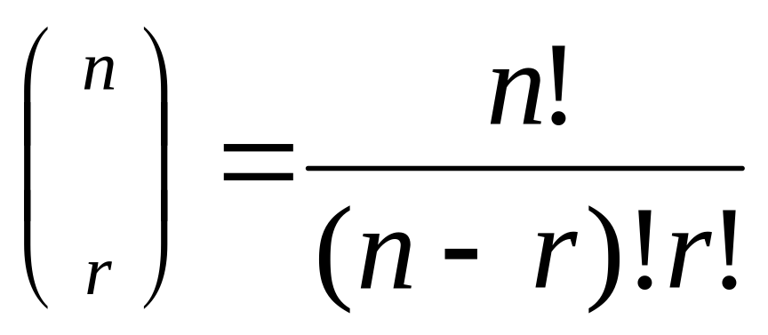
Summary: combinations
If r objects are taken from a set of n objects without replacement and disregarding order, how many different samples are possible?
Formally, “order doesn’t matter” and “without replacement”→ use choosing→

Slide 41
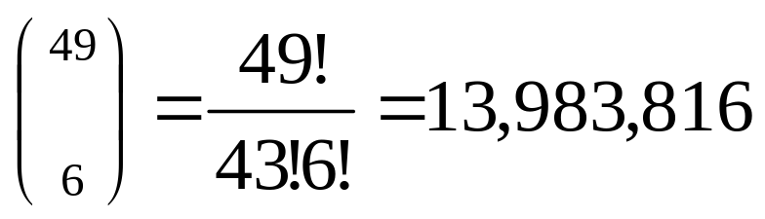
Examples—Combinations
A lottery works by picking 6 numbers from 1 to 49. How many combinations of 6 numbers could you choose?
Which of course means that your probability of winning is 1/13,983,816!

Slide 42
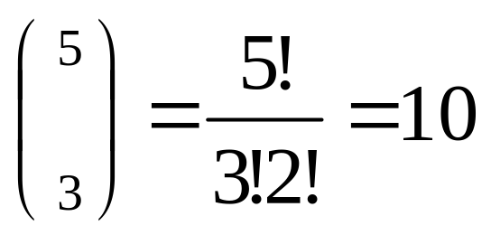
Examples
How many ways can you get 3 heads in 5 coin tosses?

Slide 43
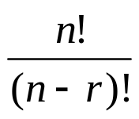
Summary of Counting Methods
Counting methods for computing probabilities
Combinations—
Order doesn’t matter
Permutations—order matters!
With replacement: n^{r}
Without replacement:
Without replacement:
n(n-1)(n-2)…(n-r+1)=

Slide 44
Gambling, revisited
What are the probabilities of the following hands?
    Pair of the same color
    Pair of different colors
    Any two cards of the same suit
    Any two cards of the same color

Slide 45
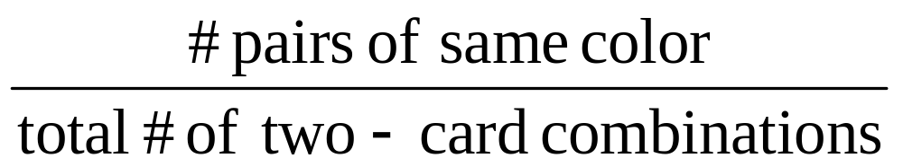
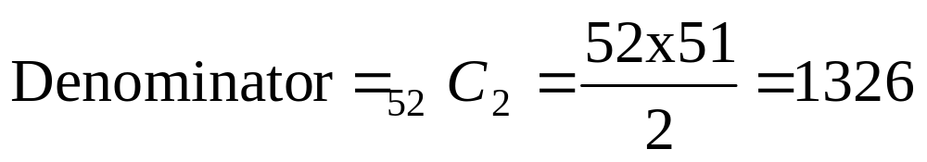
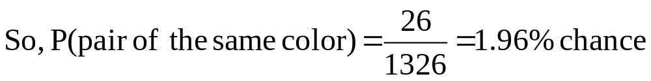
Pair of the same color?
P(pair of the same color) =
Numerator = red aces, black aces; red kings, black kings; etc.…= 2x13 = 26

Slide 46
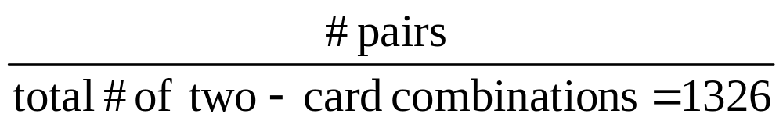
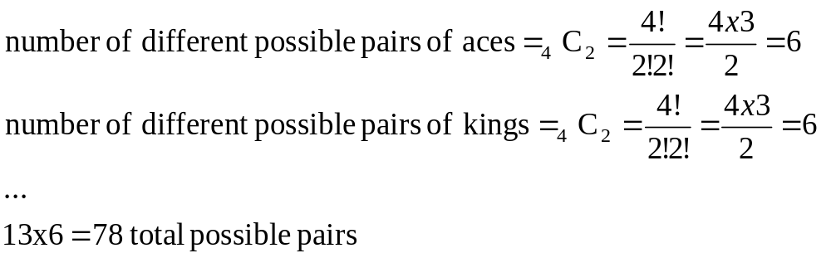
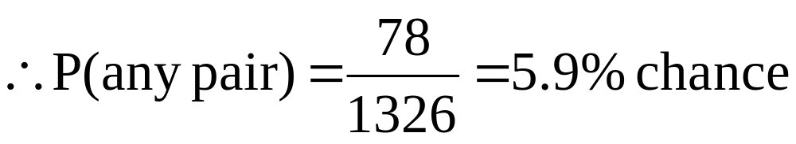
Any old pair?
P(any pair) =

Slide 47
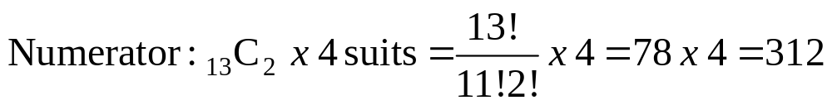
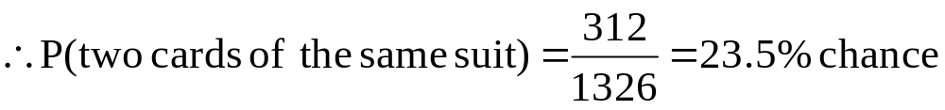
Two cards of same suit?

Slide 48
Two cards of same color?
Numerator: ₂₆C₂ x 2 colors = 26!/(24!2!) = 325 x 2 = 650
Denominator = 1326
So, P (two cards of the same color) = 650/1326 = 49% chance
A little non-intuitive? Here’s another way to look at it…
26x25 RR
26x26 RB
26x26 BR
26x25 BB
52 cards
26 red branches
26 black branches
From a Red branch: 26 black left, 25 red left
50/102
Not quite 50/100
.
.
.
.
.
.
From a Black branch: 26 red left, 25 black left

Slide 49
Rational strategy?
To bet or fold?
It would be really complicated to take into account the dependence between hands in the class (since we all drew from the same deck), so we’re going to fudge this and pretend that everyone had equal probabilities of each type of hand (pretend we have “independence”)…
Just to get a rough idea...

Slide 50
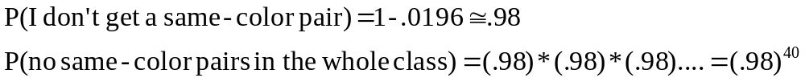
Rational strategy?
**Trick! P(at least 1) = 1- P(0)
P(at least one same-color pair in the class)=
1-P(no same-color pairs in the whole class)=

Slide 51
Rational strategy?
P(at least one pair)= 1-P(no pairs)=
1-(.94)⁴⁰=1-8%=92% chance
P(>=1 same suit)= 1-P(all different suits)=
1-(.765)⁴⁰=1-.00002 ~ 100%
P(>=1 same color) = 1-P(all different colors)=
1-(.51) ⁴⁰=1-.000000000002 ~ 100%

Slide 52
Rational strategy…
Fold unless you have a same-color pair or a numerically high pair (e.g., Queen, King, Ace).
How does this compare to class?
-anyone with a same-color pair?
-any pair?
-same suit?
-same color?

Slide 53
Practice problem:
A classic problem: “The Birthday Problem.” What’s the probability that two people in a class of 25 have the same birthday? (disregard leap years)
What would you guess is the probability?

Slide 54
Birthday Problem Answer
1. A classic problem: “The Birthday Problem.” What’s the probability that two people in a class of 25 have the same birthday? (disregard leap years)
**Trick! 1- P(none) = P(at least one)
Use complement to calculate answer. It’s easier to calculate 1- P(no matches) = the probability that at least one pair of people have the same birthday.
What’s the probability of no matches?
Denominator: how many sets of 25 birthdays are there?
--with replacement (order matters)
365²⁵
Numerator: how many different ways can you distribute 365 birthdays to 25 people without replacement?
--order matters, without replacement:
[365!/(365-25)!]= [365 x 364 x 363 x 364 x ….. (365-24)]
∴ P(no matches) = [365 x 364 x 363 x 364 x ….. (365-24)] / 365²⁵

Slide 55
Use SAS as a calculator
Use SAS as calculator… (my calculator won’t do factorials as high as 365, so I had to improvise by using a loop…which you’ll learn later in HRP 223):
%LET num = 25; *set number in the class;
data null;
top=1; *initialize numerator;
do j=0 to (&num-1) by 1;
top=(365-j)*top;
end;
BDayProb=1-(top/365**&num);
put BDayProb;
run;
From SAS log:
0.568699704, so 57% chance!

Slide 56
For class of 40 (our class)?
For class of 40?
10 %LET num = 40; *set number in the class;
11 data null;
12 top=1; *initialize numerator;
13 do j=0 to (&num-1) by 1;
14 top=(365-j)*top;
15 end;
16 BDayProb=1-(top/365**&num);
17 put BDayProb;
18 run;
0.891231809, i.e. 89% chance of a match!

Slide 57
In this class?
--Jan?
--Feb?
--March?
--April?
--May?
--June?
--July?
--August?
--September?
….

